Slide 1
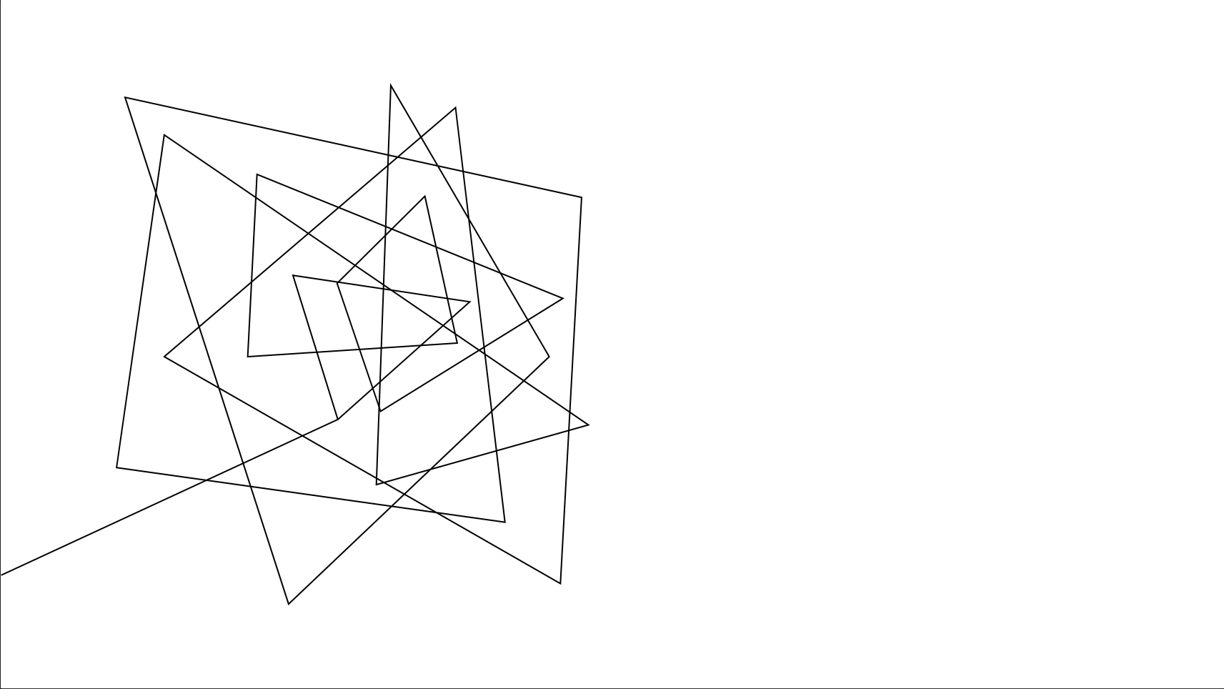
Dr. Pill
Automatic Pill Dispenser

Slide 2





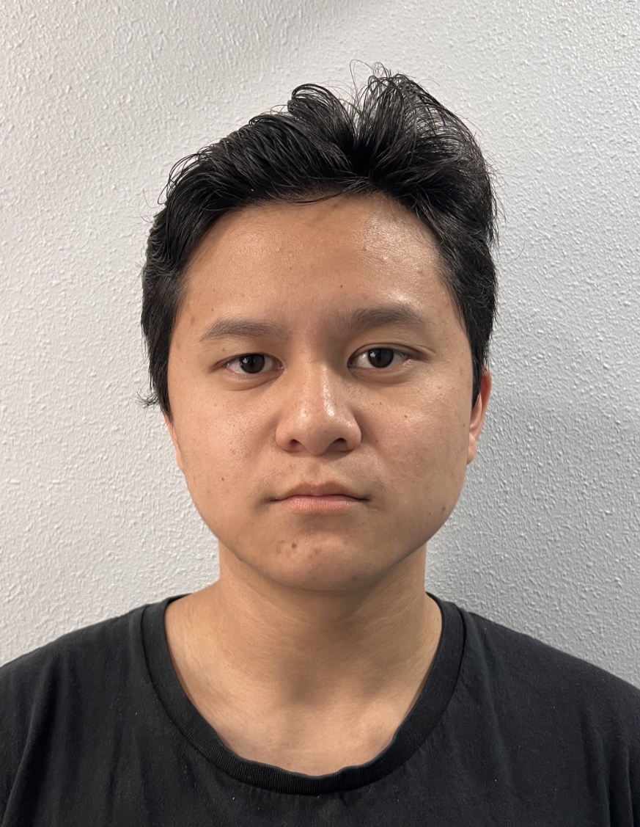
Team & Roles
Jonathan Cerniaz
Jehmel
Espiritu
Jeremy Espiritu
Joseph Guzman
Afzal
Hakim
Lee Roger
Ordinario
Power Supply & Regulation
Software Development of Interface
Software Development of Interface
3D Designing and Motor Testing for dispense mechanism
Log tracking and Security
Pill Storage System and Organization

Slide 3
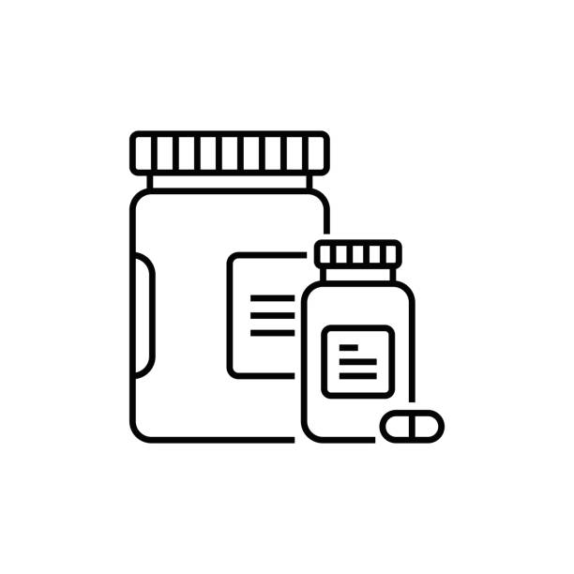
EXECUTIVE SUMMARY
Dr. Pill is an automatic pill dispenser that simplifies medication management. Our device aims to facilitate the process by freeing up more time for doctors and allowing patients to take their medication accurately by eliminating the common issue of medication errors and missed dosages.
Designated for pharmacies, nursing homes, personal households.
Dr. Pill

Slide 4
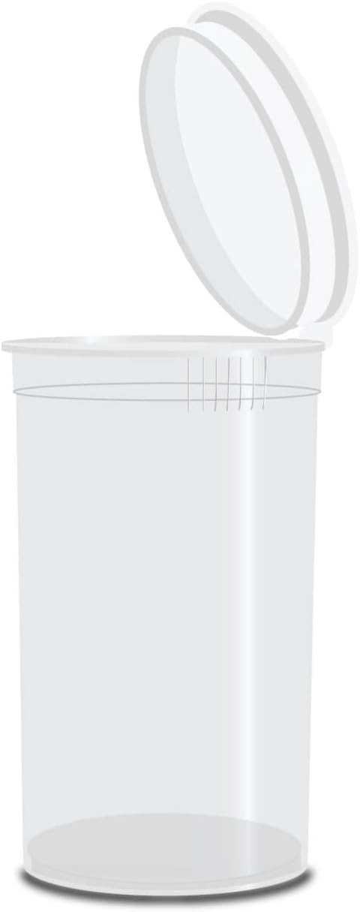
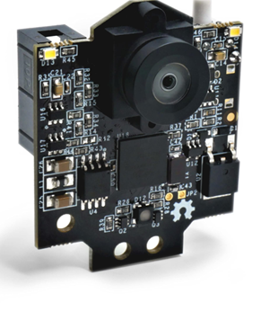
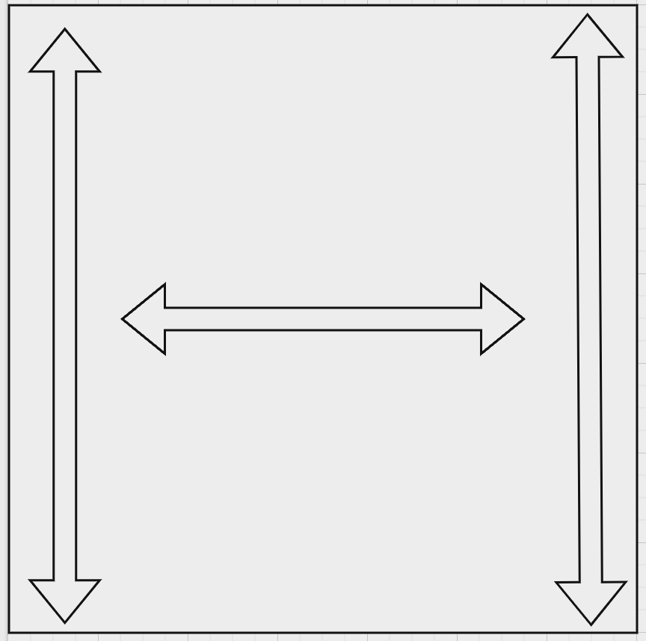
Dispense Mechanism
Features
Two Modes: Refill and On-demand
Refill: continuous dispensing of multiple pills of the same type
On-demand: Needed number of dosage dispensed at scheduled time
Object Recognition
To verify pill characteristics (color, size, pill shape, markings)
Loading Mechanism for Grid
Use of Clear Prescription Bottles for visibility
Cross-contamination Prevention
Dr. Pill
Dr. Pill

Slide 5
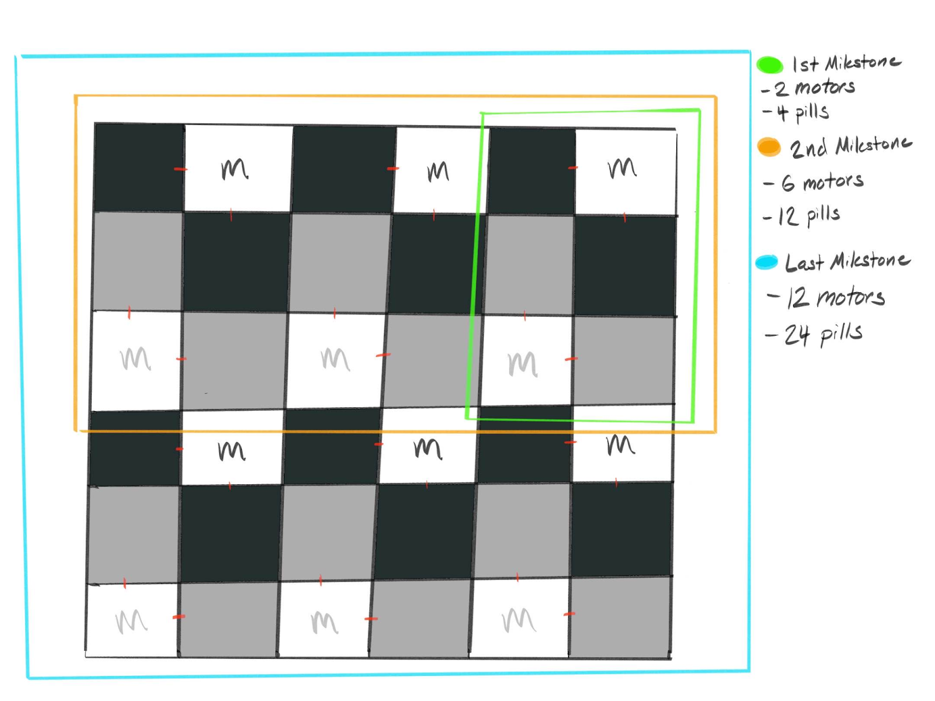
Grid System
Storage Pattern
In order to conserve space, we will be organizing the storage compartments and motors into a grid.
Under the storage, we will be using a set of motors to move a cup to the compartment of the pill being dispensed.
This shape allows us to scale the up the design easier.
Dr. Pill
Dr. Pill

Slide 6

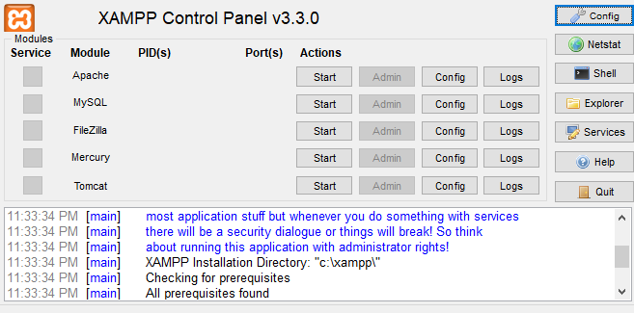
Xampp
MySQL Database: We use this to store and manage logs such as user login activity and pill requests.
Apache Server: This serves as the web server to handle user requests and process PHP scripts.
Dr. Pill
Dr. Pill

Slide 7

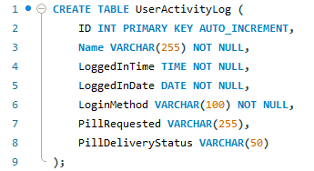
MySQL Database
Example code showing how the table columns for storing the data will be structured.
Dr. Pill
Dr. Pill

Slide 8
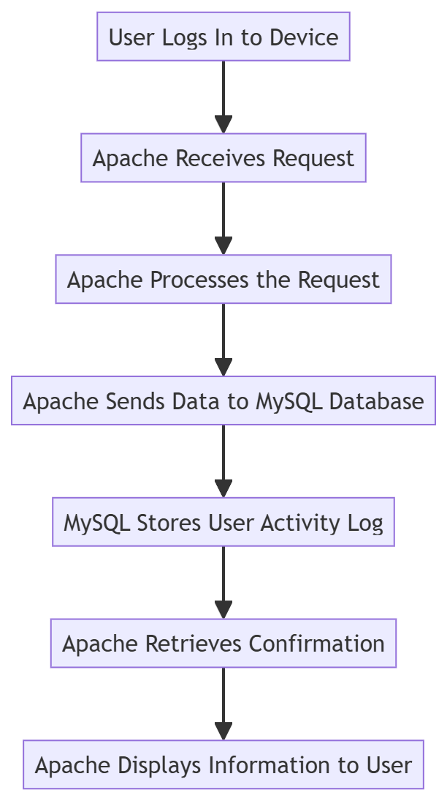

apache
When a request is made for a PHP file, Apache processes the PHP code through the PHP interpreter in XAMPP and sends the output back to the device.
Dr. Pill
Dr. Pill

Slide 9
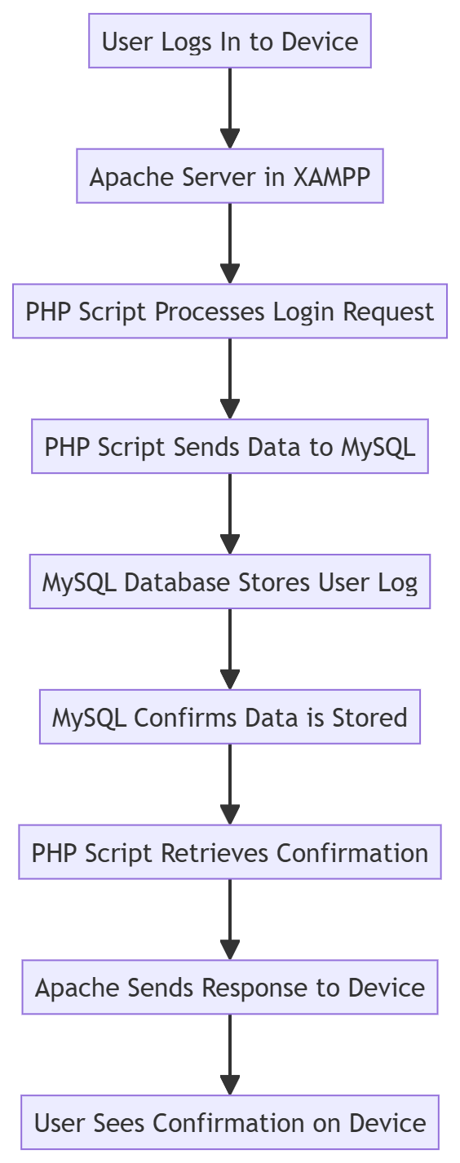
Simple flowchart of log tracking

Slide 10
Interface
Features
Staff/Patient Input
User Authentication: uses MySQL database for secure login and credential storage
MySQL Database Integration: Central for storing user data, patient records, staff actions and logs
Permission checks: ensure secure, authorized actions
Guidance Prompts: if patient is denied, directs them to seek assistance with logs recorded
Staff Input
Storage Management: Check and update inventory
Patient Management: Add/remove patient records
Logs Management: View history data
Medication Retrieval: staff can retrieve medication, with actions logged onto the database
Patient Input
Medication Retrieval: Permission-based access, logged onto the database
View History log: Patients access personal logs
Dr. Pill
Dr. Pill

Slide 11
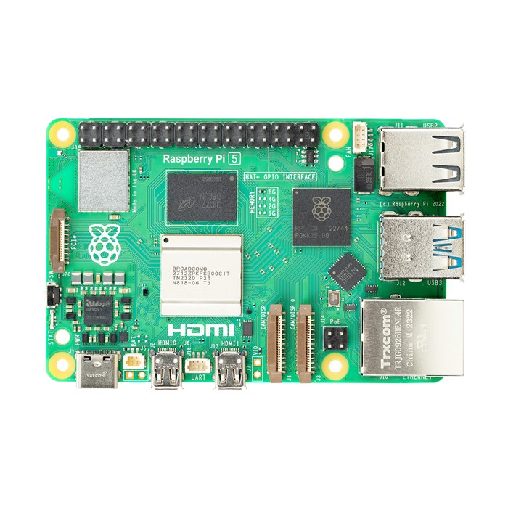
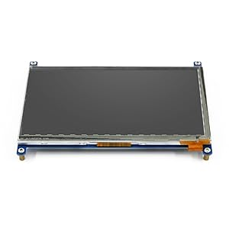
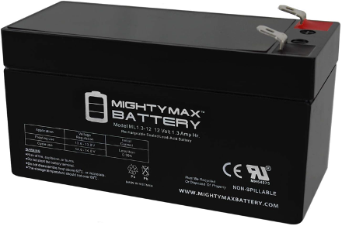
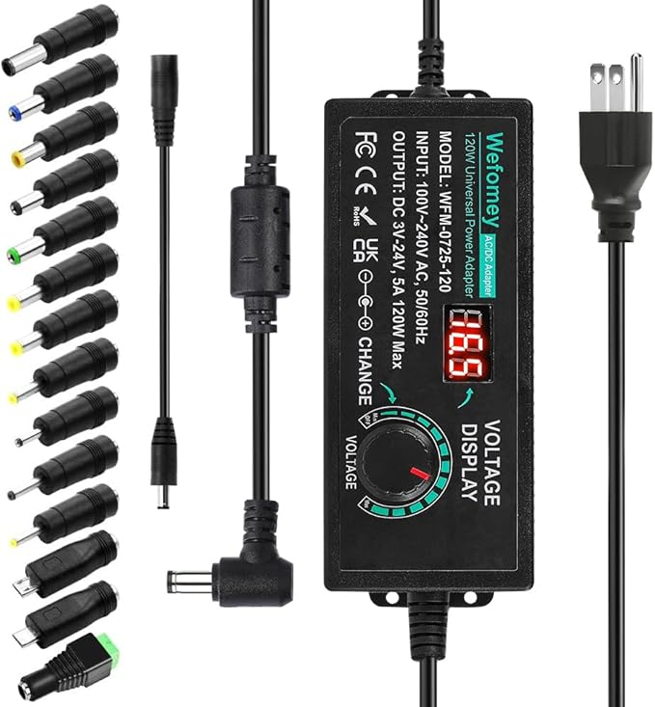
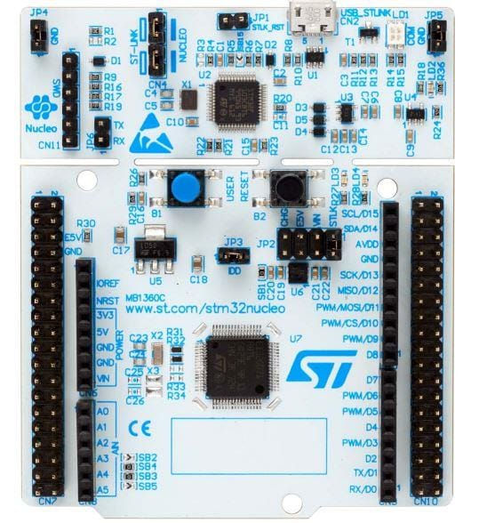
Power
Main Components Power Consumption:
Raspberry Pi 5: ~8W
STM32 Microcontroller: ~0.1W
Authentication Devices:
Fingerprint Scanner: ~0.2W
Facial Recognition: ~05W
PIN Entry System: ~0.05W
7" LCD Touchscreen Display: ~3W
Motors: ~50W
pixy2 smart vision sensor: ~1W
Total Estimate: ~62.85W
Dr. Pill
Dr. Pill

Slide 12
Progress
What was planned but not accomplished?
What was planned and accomplished?
Grid System for retrieving pills from storage
MySQL Database for tracking logs
Apache Server to handle user request and process PHP scripts
Physical 3D print of our dispense mechanism
Object recognition for identification of pills as well as the placement for the device
Circuit management and power consumption
Software development for our dispensing mechanism
Develop a user interface for patients and authorized personnel
Dr. Pill

Slide 13
First Prototype Design
Sep 27, 2024
2024
2024
Today
TIMELINE
 | 24’ Aug | 24’ Sep | 24’ Oct | 24’ Nov | 05 Dec | 25’ Jan | 25’ Feb | 25’ Mar | 25’ Apr | 25’ May
Designing & Planning
XY Grid
Power
Pill Compartment
Hardware Development
Motors
Dispensing
Software Development
UI
MySQL
Integration & Testing
Project Completion
Aug 26 – Dec 18
Oct 22 - Nov 6
Oct 22 - Nov 6
Oct 1
Nov 8
Oct 1 – Mar 1
Oct 1
Dec 1
Oct 10
Dec 1
Oct 7 – Mar 1
Oct 5
Dec 1
Oct 22
Nov 15
Feb 1 – May 9
May 9
Dr. Pill

Slide 14
REFERENCES
Alam, Md Tausif, et al. “FDA-Approved Natural Polymers for Fast Dissolving Tablets.” Journal of Pharmaceutics, U.S. National Library of Medicine, https://www.ncbi.nlm.nih.gov/pmc/articles/PMC4590815/
Alei. “Pill Size Chart.” AIPAK, 9 Apr. 2024, www.icapsulepack.com/pill-size-chart/.
Budibase. “How to Build a SQL GUI in Minutes | Budibase.” Budibase Blog, https://budibase.com/blog/tutorials/sql-gui/
Charlesworth, Christina J, et al. “Polypharmacy Among Adults Aged 65 Years and Older in the United States: 1988-2010.” The Journals of Gerontology. Series A, Biological Sciences and Medical Sciences, U.S. National Library of Medicine, www.ncbi.nlm.nih.gov/pmc/articles/PMC4573668/.
Craig M. Hales, M.D., M.P.H., Jennifer Servais, B.Sc., Crescent B. Martin, M.P.H., M.A., and Dafna Kohen, Ph.D., M.Sc., “Products - Data Briefs - Number 347 - August 2019.” Centers for Disease Control and Prevention, 14 Aug. 2019, https://www.cdc.gov/nchs/products/databriefs/db347.htm#:~:text=Among%20U.S.%20adults%20aged%2060,proton%20pump%20inhibitors%20(16.9%25/
Embedded._.programmer. "Raspberry pi setup with 7 inch touch screen." YouTube, 22 Oct. 2022, www.youtube.com/watch?v=hVn4-GMF7Eg.
Ferro Uriguen, Alexander, et al. “Determination of the Cross-Contamination and Validation of the Cleaning Process for an Automated Personalised Dosing System.” European Journal of Hospital Pharmacy : Science and Practice, U.S. National Library of Medicine, www.ncbi.nlm.nih.gov/pmc/articles/PMC9047934/.
Formlabs, “The Essential Guide to Food Safe 3D Printing.” Formlabs, formlabs.com/blog/guide-to-food-safe-3d-printing/.
Gaikwad, Manjiri. "Running SQL Server on Raspberry Pi Using Docker | A 101 Guide." Hevo Data, 31 July 2022, https://hevodata.com/learn/sql-server-on-raspberry-pi/.
Dr. Pill
Dr. Pill

Slide 15
REFERENCES
"How to Control Servo Motors with a Raspberry Pi." Digi-Key Electronics, www.digikey.com/en/maker/tutorials/2021/how-to-control-servo-motors-with-a-raspberry-pi.
"How to Setup Raspberry Pi for Beginners." YouTube, uploaded by Bytesized_Raspberry_Pi, 23 Dec. 2021, youtu.be/N_lbMR6_EBA.
J. Mark Ruscin, Sunny A. Linnebur, “Aging and Medications - Aging and Medications.” Merck Manual Consumer Version,
www.merckmanuals.com/home/older-people%E2%80%99s-health-issues/aging-and-medications/aging-and-medications.
"Pharmaceutical Packaging Design Tips for Improved Safety." Luminite, blog.luminite.com/blog/pharmaceutical-packaging-design-tips-for-improved-safety.
“Pill Counting Scales.” DSCBalances, www.dscbalances.com/collections/pill-counting-scales.​
Ranjit’s Embedded Solutions, “Arduino-based Conveyor Belt Using DC Motor with RPM Control And Object Counting”, YouTube, www.youtube.com/watch?v=VHAqJ9a7SqI.
Rosemont Pharma, “Rosemont: Information For Patients On The Dangers Of Tablet Crushing.”, 14 Oct. 2023, www.rosemontpharma.com/tablet-crushing/.
Running SQL Server on Raspberry Pi Using Docker | A 101 Guide." YouTube, uploaded by Hevo Data, 31 July 2022, https://youtu.be/uS9VvnJWoxs.
UI Bakery. “How to Build a Custom SQL Database GUI | UI Bakery.” YouTube, 20 Oct. 2020, https://www.youtube.com/watch?v=FGDwVagO1XI.
Dr. Pill

Slide 16
REFERENCES
Wang, Nathan, “What Is PLA Plastic? Benefits, Uses, and Safety of PLA Material!” Onenice Internaional Co., Ltd., 30 July 2024, www.geckohaha.com/what-is-pla-plastic/.
YouTube: Best Automatic Pill Dispensers [November 2021], www.youtube.com/watch?v=ffu1d6DnqjQ.
YouTube: Count Right Pill Counter (J1245n) - Inventory, www.youtube.com/watch?v=l1ECQJ63jCg.
YouTube: Electronic Tablet Counter: RX 4 Capsule Counter Machine by RX Count, www.youtube.com/watch?v=mO_NhPjw8f0.
Dr. Pill

Slide 17

Thank You
Dr. Pill

